Slide 1


Yankees,Phillies, Padres position WAR’s
Jonathan De La Cruz

Slide 2
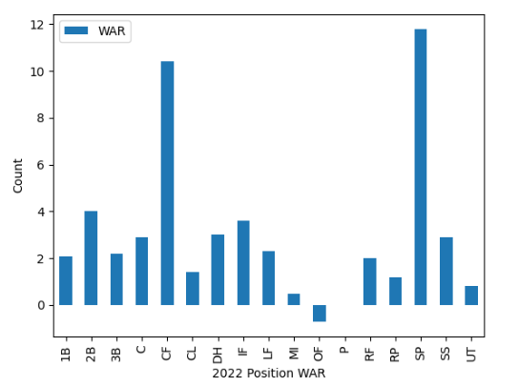
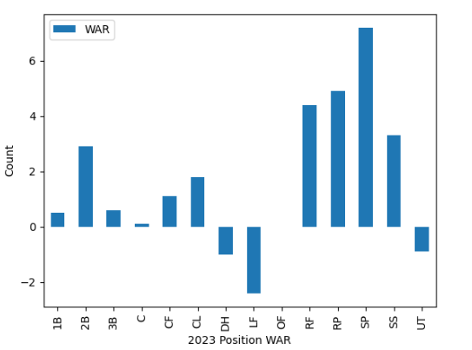
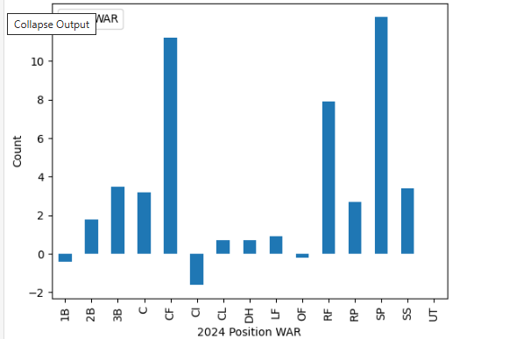


Yankee Seasons from 2022 to 2024
2022: 92-63
2023: 82-80
2024: 94-68

Slide 3
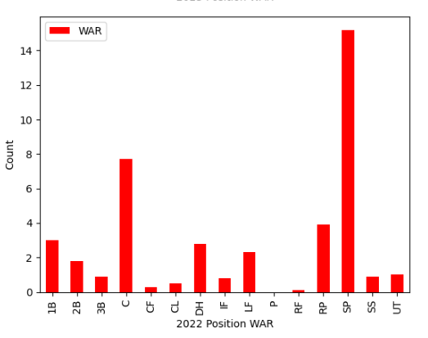
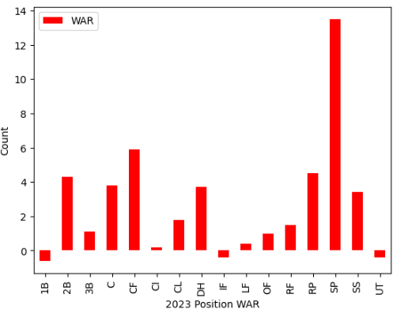
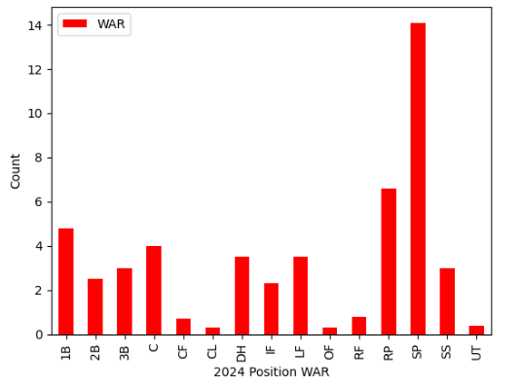


Phillies Season from 2022 to 2024
2022-87-75
2023- 90-72
2024- 95-67

Slide 4
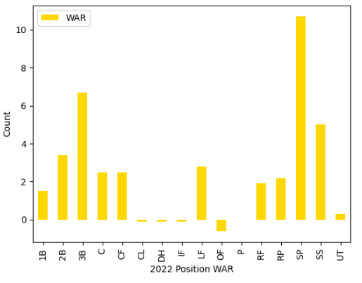
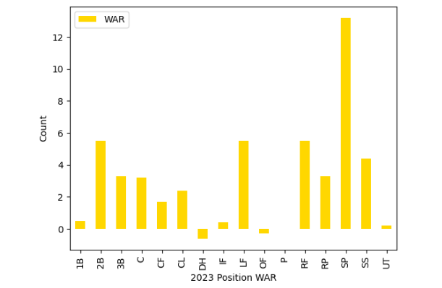
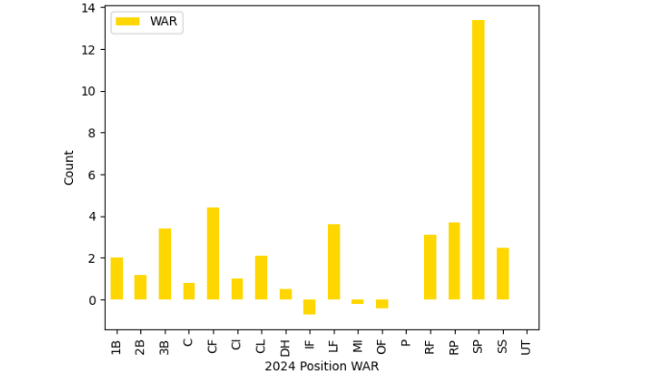


Padres seasonS FROM 2022 TO 2024
2022: 89-73
2023: 82-80
2024: 93-69

